Slide 1
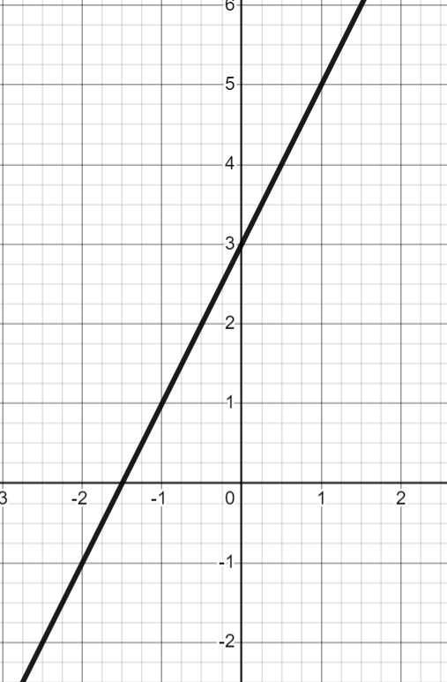
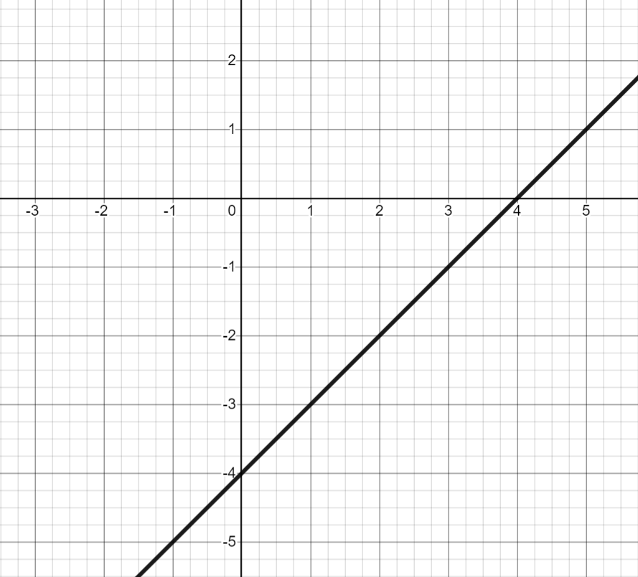
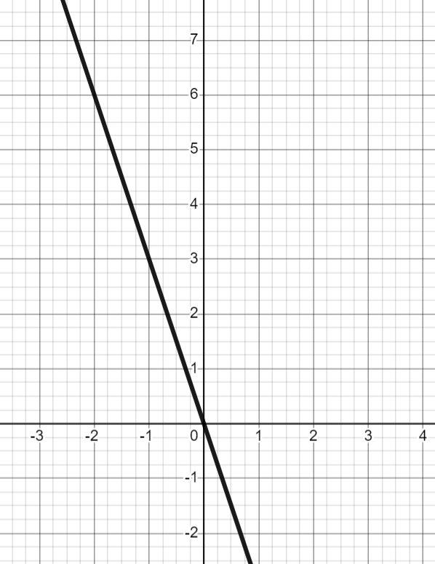
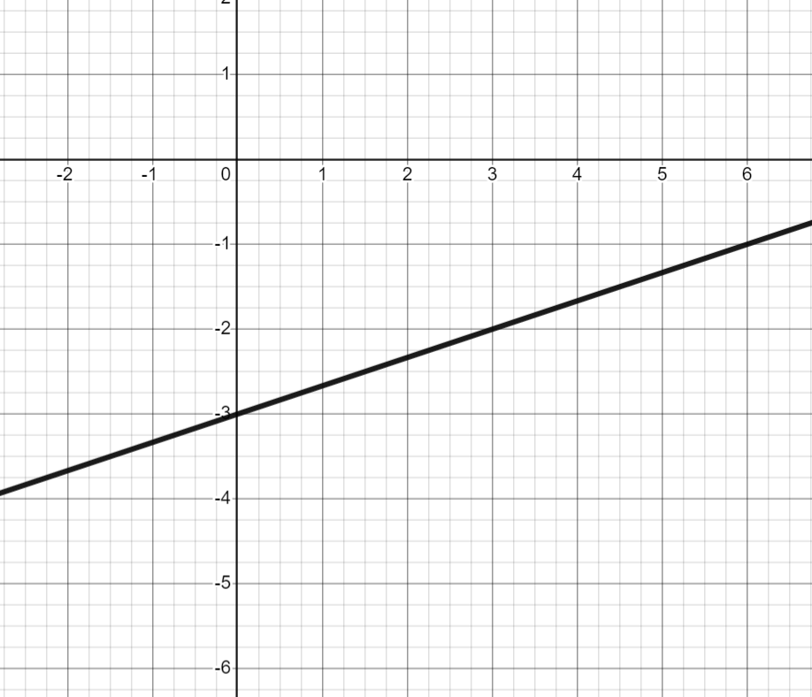
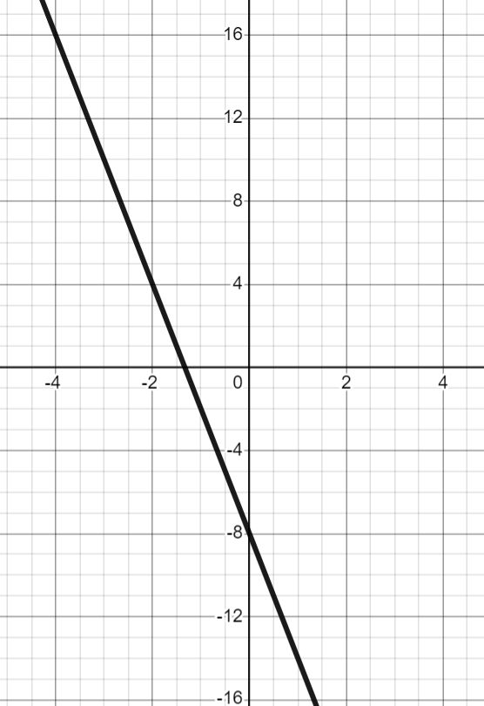
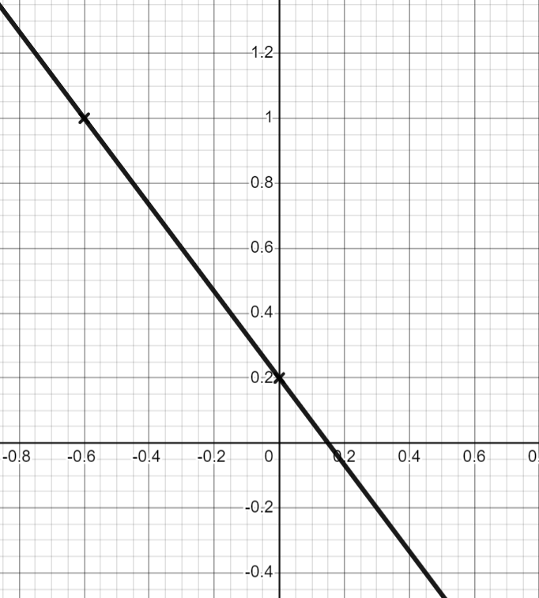
Finding the equation of the line y = mx + c
Task A: Writing the equation of a line from key features
1) For each graph, work out an equation for the line in the form y = mx + c
 | b) | c)
gradient: .
y-intercept:
equation:
gradient:
y-intercept: .
equation:
gradient:
y-intercept:
equation:
d) | e) | f)
gradient:
y-intercept:
equation: y =
gradient:
y-intercept:
equation:
gradient:
y-intercept:
equation:

Slide 2
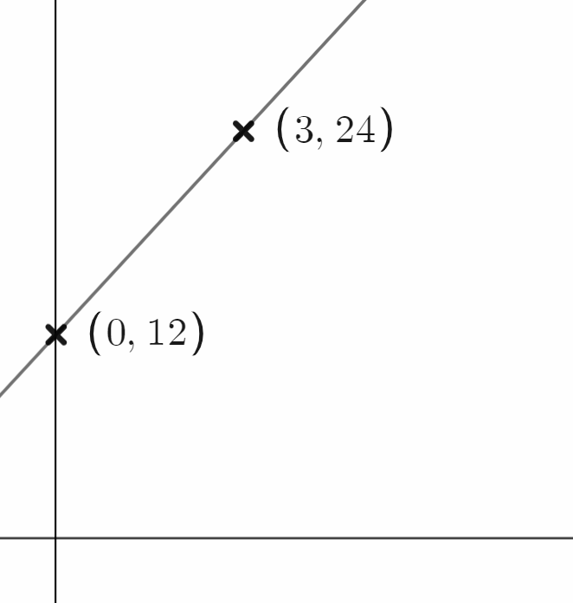
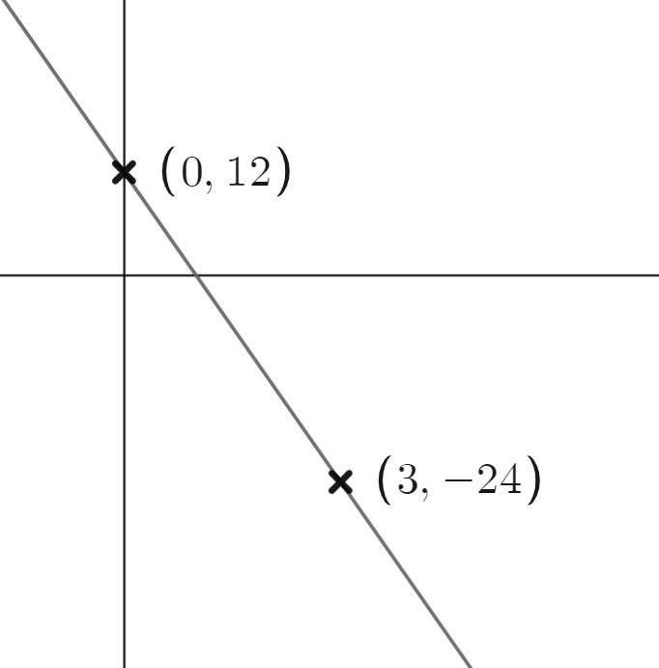
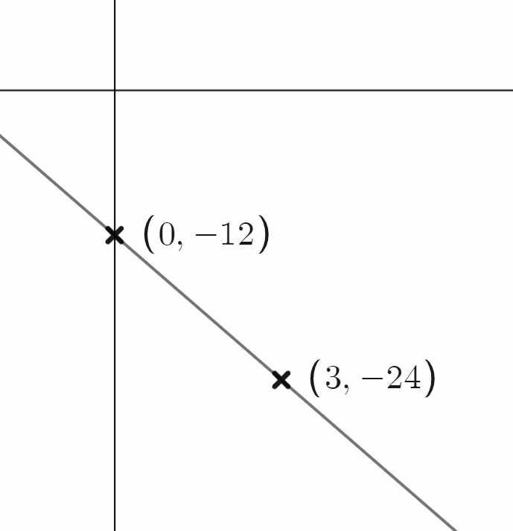
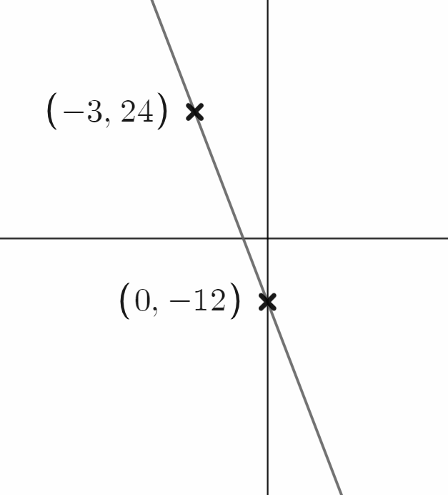
Finding the equation of the line y = mx + c
Task B: Finding the equation of a line
1) Calculate the equation of the line which has the table of values shown.
a)
b)
c)
d)
x | 0 | 1 | 2
y | −7 | −3 | 1
x | −1 | 0 | 1
y | 14 | 3 | −8
x | ….. | 1 | 2 | 3
y | ….. | 5 | 3 | 1
x | ….. | 10 | 11 | 12
y | …. | −12 | −11 | −10
2) Calculate the equation of each line.
a) | b) | c) | d)
3) Calculate the equation of the line passing through the coordinates given
a) (3, 5) and (5, 13) | b) (3, 5) and (7, −15) | c) (3, 5) and (−2, 10) | d) (3, 5) and (−15, −1)
Change x | Change y
Change x | Change y
Change x | Change y
x | 0 … | 3 … | 5
y |  | 5 … | 13
x | 0… | 3 … | 7
y |  | 5 … | −9
x
y
Equation:
Equation:
Equation:
Equation:
Mathematics in Education and Industry
v2.2

